Slide 1
Serverless with Azure
Andrej Kyselica
Pete Roden

Slide 2
Serverless, the future platform for next gen apps
How do I architect my app to become Serverless?
Notes:
Talking points: (New)
What do we go from here?
Introducing Serverless, an event-driven process, which will grow and scale on demand.
The only remaining question now becomes: How I architect my app to become Serverless? Pretty neat, right?
It all sounds great, naturally, you may ask, how does Serverless fit into the picture?

Slide 3
What is Serverless?
$
Abstraction of servers
Event-driven/ instant scale
Micro-billing
Notes:
Abstraction of servers, infrastructure and configuration of operating system
Event-driven scale
Sub-second billing
Stateless
Serverless compute is a fully managed service. Some refer to it as Functions as a Service
OS and Framework patching is performed for you
There is zero administrative tasks and no need to manage any infrastructure
You just deploy your code (function) and it runs
Your code runs within seconds and for very short period of time
Serverless compute scales quickly (almost instantly) and vastly
Automatically scales within seconds
No scale configuration is required (there is no way to configure scale or limits)
Scales to match any given workload. Scales from zero to handle tens of thousands concurrent functions invocations within seconds
Pay only for the time your code is running
Serverless compute reacts to events
React, in near real-time, to events and triggers
Triggered by virtually any event from Azure service or 3rd party services
Setup time, provisioning is long & costly

Slide 4
Benefits of Serverless
Reduced DevOps
Focus on business logic
Faster time to market
Notes:
“Pinnacle of PaaS compute”
Not just hardware “servers”, but software servers are also managed for you
Focus on business logic, not solving technical problems not core to business
Lower effort to get started makes it easier to experiment (bots, etc.)
Benefits of “Serverless”

Slide 5
Build apps faster with Serverless
Serverless
Value to business
Innovation
PaaS
Efficiency
IaaS
Time
Notes:
In today’s cloud enabled world, businesses are solving for maximum efficiency and faster time to market, while reducing IT spend.
Over the years we have seen businesses evolve from spinning VMs to leveraging the benefits of PaaS cloud such as managed infrastructure, scalability, high availability and cost.
Today, more businesses are trying to solve for what is core to their business focus – delivering services faster to their customers, while reducing IT spend significantly. The answer comes in the form of Serverless application platform.
In industry terms, when you hear someone say “Serverless” more often than not they are talking about Serveless Compute services which form the glue that enable developers to build their apps faster leveraging a variety of other PaaS services.
Serverless lets businesses maximize their benefits of the PaaS cloud by offering a fully managed infrastructure, with no servers to manage, provision and patch; hence reducing management overhead significantly. The event triggered programming model, allows for continuous auto-scaling and micro billing capabilities. Event-triggered compute and event-triggered scaling allows businesses to pay only for the compute power that was used, depending on the size of the workload.

Slide 6


Serverless application platform components
Development
Platform
IDE support
Functions
Logic apps
Developer tooling
Bindings and triggers
Open source
Visual designer
100+ connectors
Functions orchestration
Visual debug history
Local development
Data/storage
Messaging
Gateway Connectors
Intelligence
Bots
Verbose debugging
Notes:
TIME MARKER (COMPLETE SLIDE): 10:10 A.M.
Talking Points: (Updated on 4/3/17)
Lets talk about what really makes up MSFT’s Serverless platform: At the center of the Serverless platform, is our compute offerings: Azure Functions and Azure Logic Apps. Azure Functions is an event based Serverless compute experience that helps you accelerate your development. Run time is open. Function code can be executed in vm or somewhere else, on prem or in clould. Logic Apps is a powerful orchestration tool. It enables building a Serverless app in minutes – by orchestrating multiple functions using a visual workflow tool.
Say you have your apps up and running using Serverless. Congratulations! You now need to collect intelligence from different apps across platforms to take actions upon. There are a few essential components which we think are core to building Serverless applications are:
Data/ Storage –Functions has triggers and bindings with Azure document DB and Azure Blob storage
** Triggers: Triggers are event responses used to trigger your custom code. They allow you to respond to events across the Azure platform or on premise.
** Bindings: Bindings represent the necessary meta data used to connect your code to the desired trigger or associated input or output data.
Messaging such as queues and topics using Azure Service Bus and Azure Event Hubs
Integration – that includes core LOB apps and SaaS apps integration via Azure Logic Apps.
Intelligence on data and sentiment/ predictive analysis using Cognitive services and Machine learning
Conversation as a service – how do we equip developers to build apps that offer an end-to-end experience for their end users – Azure Bot Service offers a Serverless interactive bot experience.
More, developers are spending more time writing code that allows them to add huge business impact with Serverless. MSFT offers numerous development tools such as IDE Support for Visual Studio in functions and Logic Apps, enables local development (vs web browser coding environment), visual debugging capability, all with your tools of choice.
Lastly, I also want to highlight top scenarios and use cases for Serverless:
Real-time Stream analytics: Customers can use Functions to feed real-time streams of data from application tracking into structured data and store it in SQL online.
SaaS event processing: Customers can use Functions and Logic Apps to analyze data from an excel file in Onedrive and perform validation, filtration, sorting and convert data into consumable business charts
Web app architecture: Used a lot in creating targeted marketing collaterals – when a customer clicks on a webpage, it triggers a webhook, that uses a function to create an ad that matches the customer profile and displays a completed webpage.
Real-time bot messaging: When customers send a message to a chatbox, Functions calls Cortana analytics to generate appropriate answers and sends a response back.
//from before: Customers have different paths to build a Serverless app – start by building the distributed application components using functions by leveraging the numerous templates and declarative bindings Or
Start with the workflow and orchestration of Serverless application using Azure Logic Apps. The visual designer enables developers to quickly and easily author, edit and visualize orchestration of multiple functions and workflow.

Slide 7


Introducing Functions
Code
Azure Functions
Events + data

Slide 9
What is “serverless”
Abstraction of servers
Event-driven scale
Sub-second billing
Notes:
Abstraction of servers, infrastructure and configuration of operating system
Event-driven scale
Sub-second billing
Stateless
Serverless compute is a fully managed service. Some refer to it as Functions as a Service
OS and Framework patching is performed for you
There is zero administrative tasks and no need to manage any infrastructure
You just deploy your code (function) and it runs
Your code runs within seconds and for very short period of time
Serverless compute scales quickly (almost instantly) and vastly
Automatically scales within seconds
No scale configuration is required (there is no way to configure scale or limits)
Scales to match any given workload. Scales from zero to handle tens of thousands concurrent functions invocations within seconds
Pay only for the time your code is running
Serverless compute reacts to events
React, in near real-time, to events and triggers
Triggered by virtually any event from Azure service or 3rd party services

Slide 10
How is it different
Mono-lithic application
Inside client app
Complex framework
Loosely coupled components
Outside client app
Micro-functionality
Notes:
Mono-lithic application -> loosely coupled components
Events happening async outside client application
Build/use micro-functionality to react to a single event

Slide 11
Benefits of “serverless”
Ship faster
Reduced dev ops
Focus on business logic
Notes:
“Pinnacle of PaaS compute”
Not just hardware “servers”, but software servers are also managed for you
Focus on business logic, not solving technical problems not core to business
Lower effort to get started makes it easier to experiment (bots, etc.)

Slide 12
Signs that a serverless pattern might be useful for a given scenario
Stateless → Scale
Not worth deploying a traditional backend
Workload is sporadic (very low & high scale)
Dev ops favored versus dedicated ops
Lots of different services involved that need “glue”

Slide 13
Applications
Example: Timer based processing
Eve
r
y 15 minutes
Find and clean invalid data
Clean table

Slide 14
Applications
Example: Azure service event processing
CSV
File added to
T
ransfo
r
m CSV to data
r
ows
P
ower BI
Blob Storage
Cha
r
t graphic

Slide 15
Pete’s Blob Demo
Blob Storage Replicator
C#
https://funcycopycs.azurewebsites.net
https://github.com/codingwithsasquatch/azfunc-storage-replicator-csharp
JS
https://funcycopyjs.azurewebsites.net
https://github.com/codingwithsasquatch/azfunc-storage-replicator-js

Slide 16
Applications
Example: SaaS event processing
Excel file saved
Mic
r
os
o
f
t Graph API analyzes content
C
r
eates new sheets
to OneDrive
with cha
r
ts

Slide 17
Applications
Example: Serverless Web Applications architectures
Loaded web page
C
r
eate ad based on user p
r
o
file
Completed page
calls
W
ebHook

Slide 18
Pete’s SPA application
https://github.com/codingwithsasquatch/functions-js-spa
https://funcyspa-4ivis7.azurewebsites.net/

Slide 19
Async background processing
Example: Serverless Mobile back ends
Photo taken and
Sto
r
es in blob storage
P
r
W
ebHook called
oduces scaled images

Slide 20
Applications
Example: Real-time stream processing
Millions
o
f devices feed
T
ransfo
r
m to structu
r
ed data
Sto
r
e data in
into St
r
eam Analytics
SQL Online

Slide 21
Andrej’s IoT Demo
https://github.com/codingwithsasquatch/iot-hub-monitoring-client-bmp085

Slide 22
Applications
Example: Real-time bot messaging
...
?
Co
r
tana Analytics answe
r
Message sent
s questions
Chatbot sends
to Chatbot
r
esponse

Slide 23


Integration
Example: Invoice Processing
API Management
Logic App
Function
Post new invoice
Convert to JSON
Grab raw file
Store record
API layer
Fetch Invoice
Notes:
Chris

Slide 24
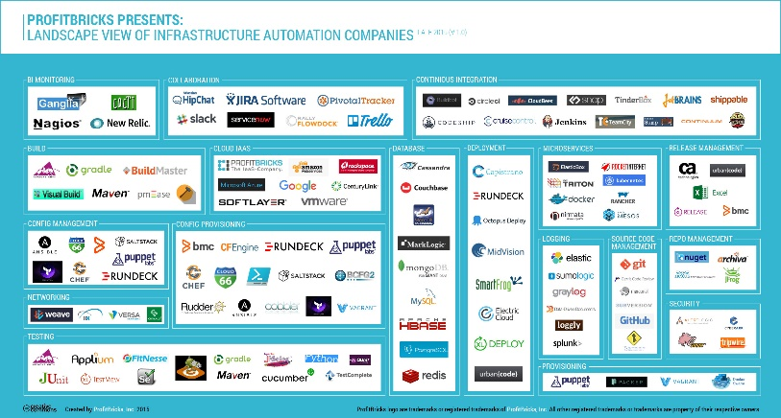
Microservice tools and approaches
Microservices in the wild
Azure Functions
Azure Service Fabric
Implication: Build your own microservices platform
Benefits: Customizable, pick best of breed solutions
Implication: Serverless microservices
Benefits: Quick ramp up, sub second metering, zero ops
Implication: Prescriptive microservices platform
Benefits: Easy to build, deploy and manage microservices at scale
Event-driven scale
No Ops

Slide 25
New Visual Studio 2017 tooling
Based on class libraries
Get the full power of IntelliSense, unit testing, and local debugging
Use WebJobs attributes to define triggers and bindings
Learn more at https://aka.ms/2017functiontools

Slide 26
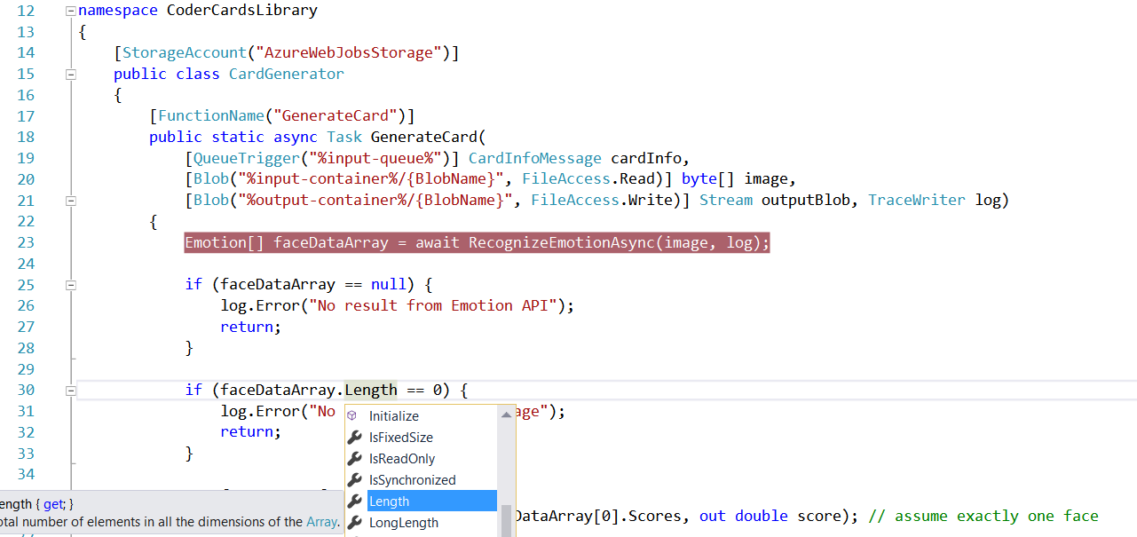
Visual Studio 2017 Tooling

Slide 27
Advanced stuff
Functions CLI and debugging
Proxies
Durable Functions: https://azure.github.io/azure-functions-durable-extension/

Slide 28
Patterns to follow
Similar to microservice patterns (12 factor)
Keep execution short and return quickly
Use queues, service bus, etc. to decouple tasks (better scaling and responsiveness)
Compile and or pack to optimize cold start times

Slide 29
Platform and scaling
App Service offers dedicated and dynamic tiers.
Dedicated is the existing App Service plan tiers
Basic, Standard, Premium
Pay based on # of reserved VMs
You’re responsible for scale
Dynamic
Pay on number of executions
Platform responsible for scale

Slide 30
Dynamic tier pricing
Pay per execution model - two meters, three units
Number of executions
Duration of execution x reserved memory
First million executions free.

Slide 31
Introducing Azure Logic Apps
Powerful Integration and Workflow Engine born in Azure
Fast integrations using a visual designer and workflow creation with triggers and actions
Connect applications, data and services
Connect and orchestrate Azure Functions
Notes:
-Started with BizTalk server (in for 17 years) – how can we move things faster between enterprise integration? LogicApps was born out 100% out of Azure.
-how to reduce integration from weeks/months to days?

Slide 32
Logic Apps
SaaS
Protocols/Native
appFigures
Asana
Azure API Management
Azure App Services
Azure Automation
Azure Cognitive Face API
Azure Cognitive LUIS
Azure Cognitive Text Analytics
Azure Cognitive Vision
Azure Data Lake Store
Azure Document DB
Azure Event Hub
Azure Functions
Azure Machine Learning
Azure Resource Manager
Azure Service Bus
Azure SQL
Azure Storage Blob
Azure Storage Queues
Basecamp
Bing Search
BitBucket
Bitly
Blogger
Box
Buffer
Campfire
Chatter
Common Data Service
Disqus
DocuSign
Dropbox
Dynamics AX Online
Dynamics CRM Online
Dynamics CRM Service Bus
Dynamics Financials
Dynamics Operations
Easy Redmine
Eventbrite
Facebook
FreshBooks
Freshdesk
GitHub
Gmail
Google Calendar
Google Contacts
Google Drive
Google Sheets
Google Tasks
GoTo Meeting
GoTo Training
GoTo Webinar
Harvest
HelloSign
Infusionsoft
JIRA
Insightly
Instagram
Instapaper
MailChimp
Mandrill
Medium
Microsoft Project Online
Microsoft Translator
MSN Weather
Muhimbi PDF
Office 365
Office 365 Users
Office 365 Video
OneDrive
OneDrive for Business
OneNote
Outlook.com
Outlook Tasks
PagerDuty
Pinterest
Pipedrive
Pivotal Tracker
Power BI
Project Online
Redmine
Salesforce
Salesforce Chatter
SendGrid
SharePoint Online
Slack
SmartSheet
SparkPost
Stripe
Survey Monkey
Todoist
Toodledo
Trello
Twilio
Twitter
Typeform
UserVoice
VS Team Services
Webmerge
Wordpress
Wunderlist
Yammer
YouTube
Zendesk
HTTP, HTTPS
HTTP Webhook
FTP, SFTP
SMTP
RSS
Compose, Query, Parse JSON
Wait
Terminate
Workflow
Cloud APIs and platform functionality
Over 120 built-in connectors
Hosted and managed within the platform
Scales to meet your needs
First class designer experience
Rapid development
XML and EDI
XML Validation
Transform XML (+Mapper)
Flat File Encode
Flat File Decode
X12
EDIFACT
AS2
Integration Account Artifact Lookup
API connections
Authenticate once and reuse
Differentiate connection configuration
Simple to deploy
Portal experience for managing API Connections
Hybrid
BizTalk Server
File System
IBM DB2
Informix
Oracle DB
SharePoint Server
SQL Server
SAP
Websphere MQ
Notes:
Call out that we now support stored procs on-prem

Slide 33
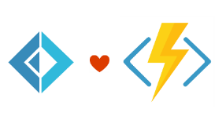


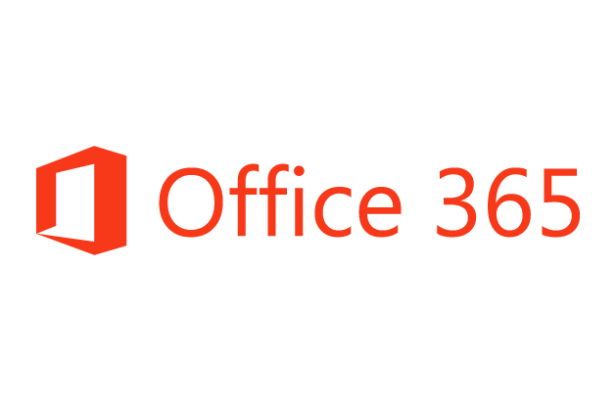


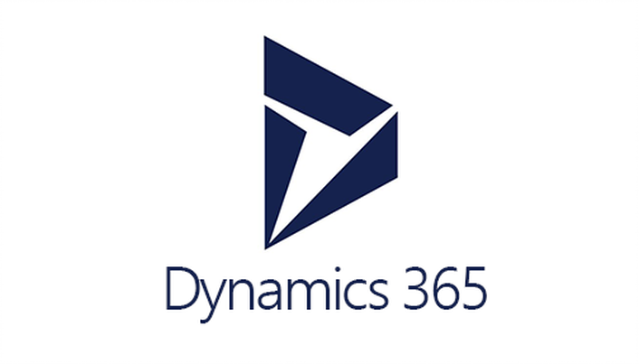



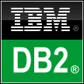
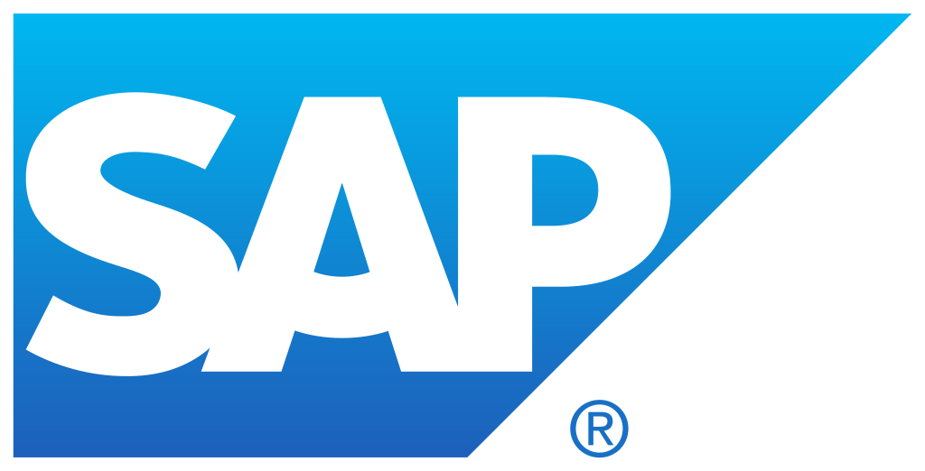


Logic Apps connects everything
Azure Functions
Service bus
Cognitive services
Logic Apps
Machine learning
On-premises data gateway
BizTalk server
Notes:
Logic Apps can integrate with “anything” (APIs) and solve small or complex problems. Automation in a secure and reliable environment fast and easy.
Connect Anything:
On-premises, hybrid and cloud
Mission critical, complex integration scenarios
Business productivity
Agile Business:
Quickly create workflows
Position to the future API centric
Transform Business:
Extract value from both (on-premises and cloud apps)
Build Holistic integration solutions.

Slide 34
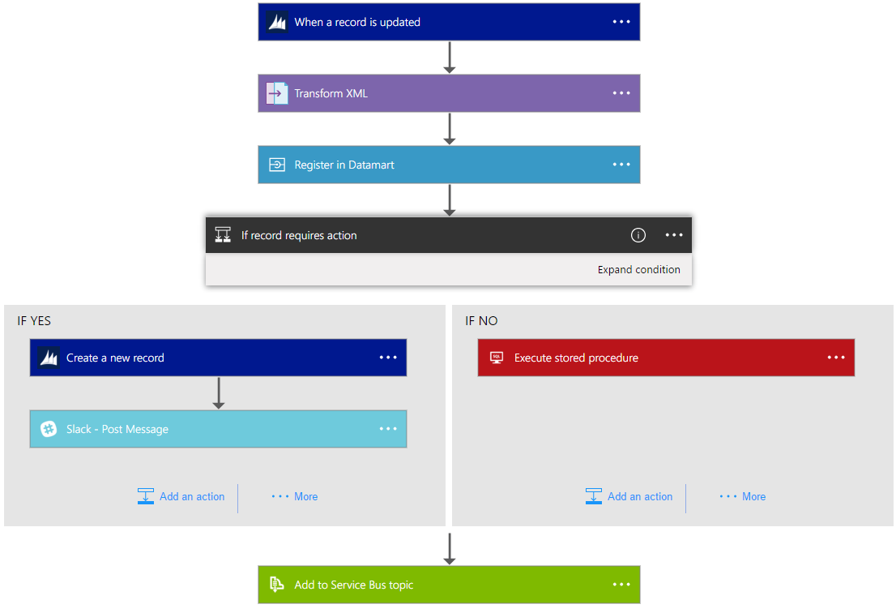
Logic Apps Workflow Designer
Workflow in the cloud
Powerful control flow
Connect disparate applications
No code designer for rapid creation
Also works within Visual Studio for added CI/CD

Slide 35
Logic Apps Demo
Notes:
TIME MARKER: 10:40 A.M.

Slide 36
Summary: build apps faster
Functions
Logic Apps
Consumption and provisioned options
Local development and advanced DevOps with detailed monitoring
Bindings to first and third-party services
Open source runtime
Rich portal visual designer and Visual Studio integration
Switch statements and loops
120+ connectors to SaaS and PaaS, with custom connector support
ARM template-based for easy reuse

Slide 37
Questions?

